Slide 1
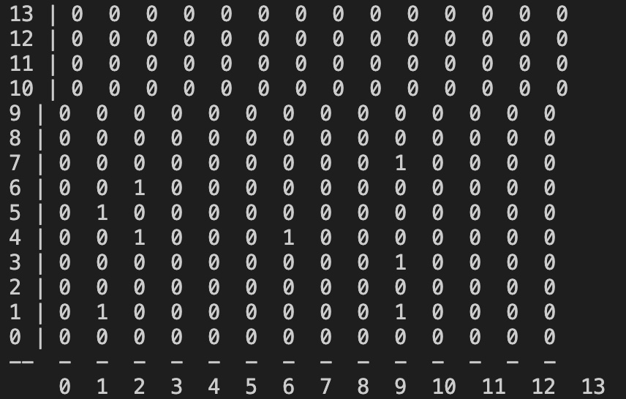
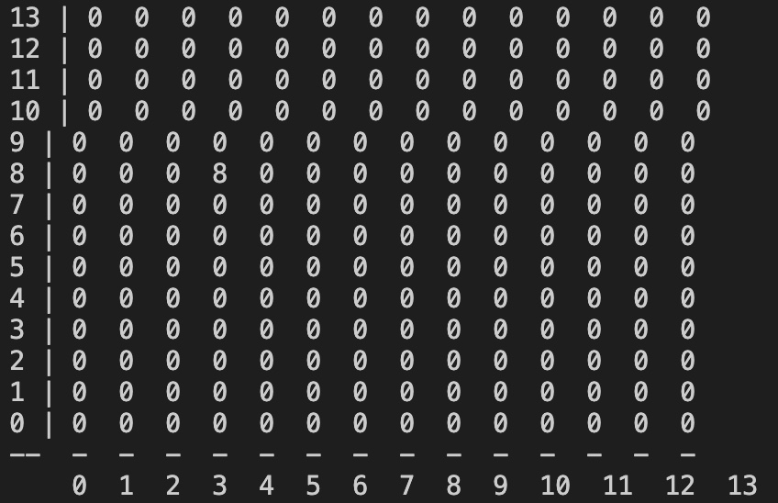
Figure 1 – Initial grid with 8 robots
Figure 2 – Updated grid after call to aggregate,
All 8 robots at position (3,8)

Slide 2
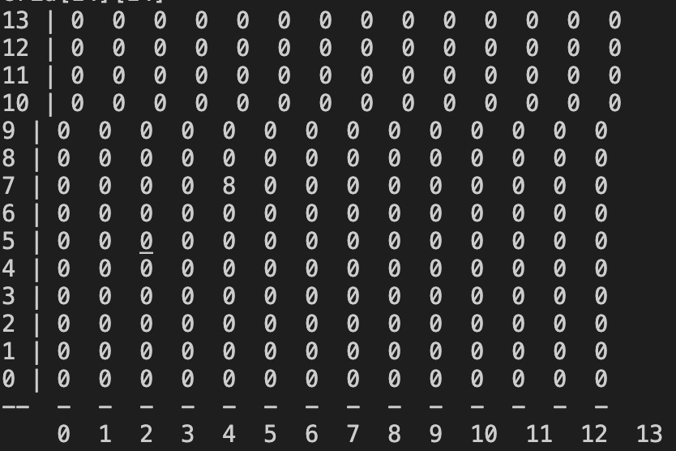
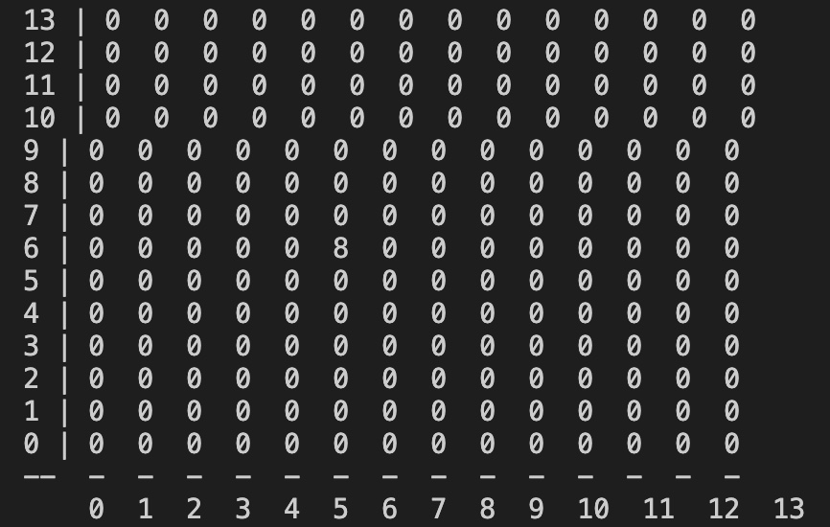
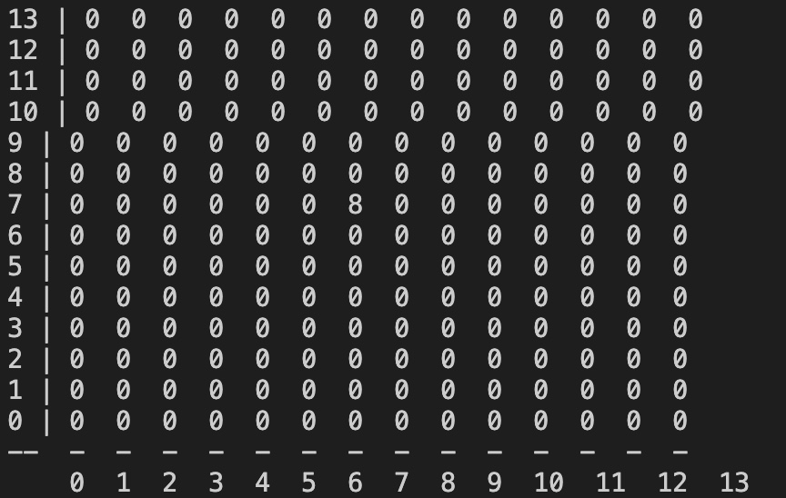

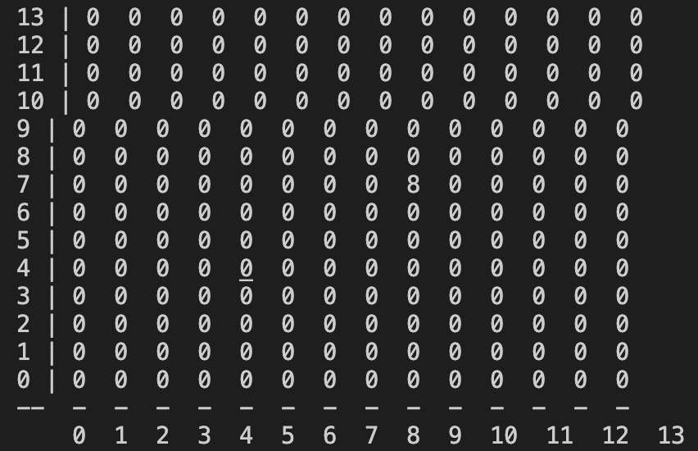
Figure 3a – all robots at (4,7)
Safe wander 0
Figure 3b – all robots at (5,6)
Safe wander 1
Figure 3c – all robots at (6,7)
Safe wander 2
Figure 3d – all robots at (7,6)
Safe wander 3
Figure 3e – all robots at (8,7)
Safe wander 4

Slide 3


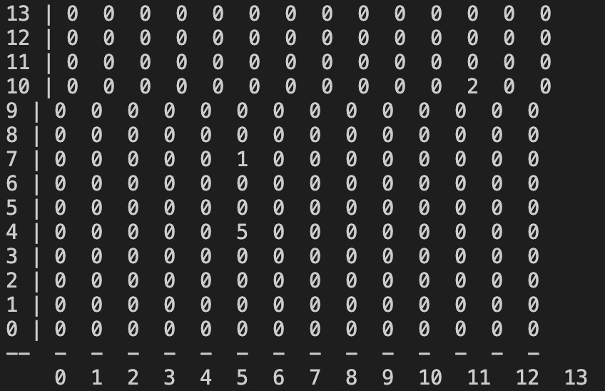
Figure 4a – disperse from (8,7)
Disperse 0
Figure 4b – disperse from (8,7)
Disperse 1
Figure 4c – disperse from (8,7)
Disperse 2

